Slide 1
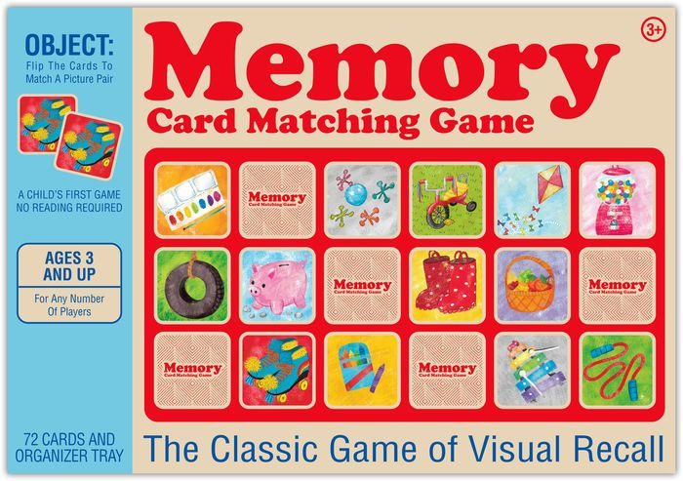
Computer Science 210 Memory
Caleb Song Maj Sample T6

Slide 2
Project Overview
Memory Game
2 players
Each take turns flipping cards
If cards match then they will stay revealed
If not they will be temporarily revealed then flipped over
Game ends when all cards are flipped over
Person with most matches is the winner
Prints answer key and score to a file

Slide 3
Live Demonstration

Slide 4
Core Functionality
INSTRUCTIONS: List the basic and advanced programming skills your final project implements, and discuss how you used it.
Basic Programming Skills
Dynamic Memory (malloc and free) - Deck
Pointers – character array, player score
Processing of Array Data – Nested For loop to assign card values
File I/O – Output answer key to a file
Structs – Struct of player name and score
String Manipulation
Advanced Programming Skills
2D Arrays – Deck is 2d array
Recursion

Slide 5
Estimates vs. Reality
INSTRUCTIONS: Fill out the table.
 | Estimate | Actual
# of Lines (Main Program): | 400 | 282
# of Lines (Test Bench): | 100 | 150
# of Hours: | 5-7 | 7-9
What do you think the biggest challenge will be? | Setting random characters in array | playerTurn function to update the board/temporarily reveal cards

Slide 6
Project Evaluation
No deviations from original project design
Test Plan: Hard to automatically test to ensure only pairs of cards were set in the Deck
Most difficult: Working with the decks to set card pairs and updating card pairs
Learned: Using functions to break up large programs into pieces is very helpful for coding, debugging, and testing.

